Slide 1

AtliQ Telecom Analysis
Geetha

Slide 2
Introduction
5G
AtliQ is one of the leading telecom providers in India and launched it’s 5G plans in May 2022 along with other telecom providers.
However, the management noticed a decline in their active users and revenue growth post 5G launch in May 2022.
LAUNCH — MAY 2022

Slide 3
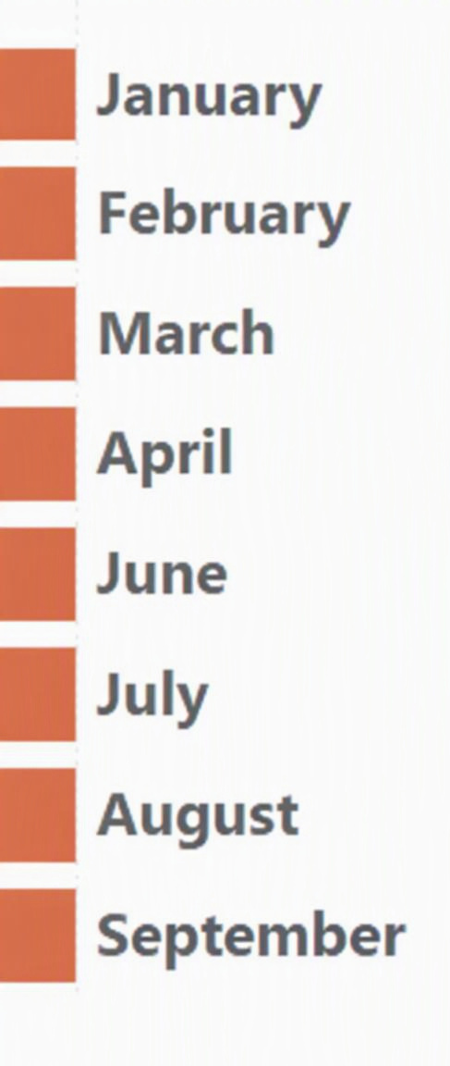
Details of Data
Before 5G
May – 5G Implementation – No data
After 5G

Slide 4
Main KPIs
01
ARPU
02
Revenue
Average Revenue Per User
Revenue for all the plans
03
Active users
04
Unsubscribed users
Number of Persons who are using the network
Number of Persons who left the network

Slide 5
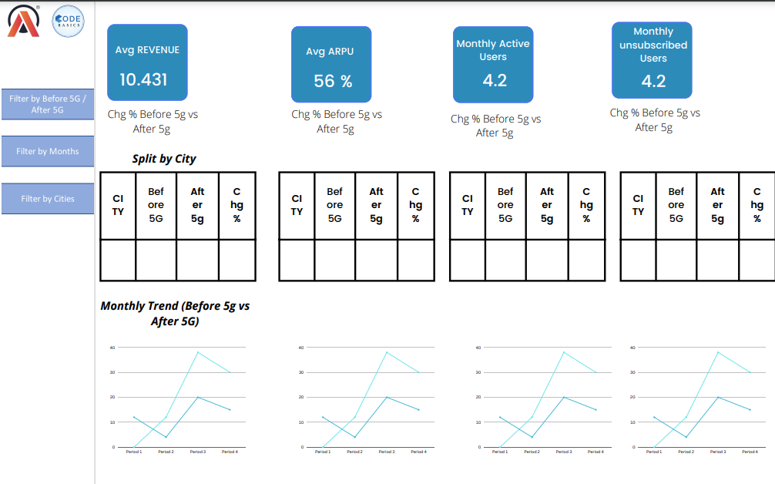
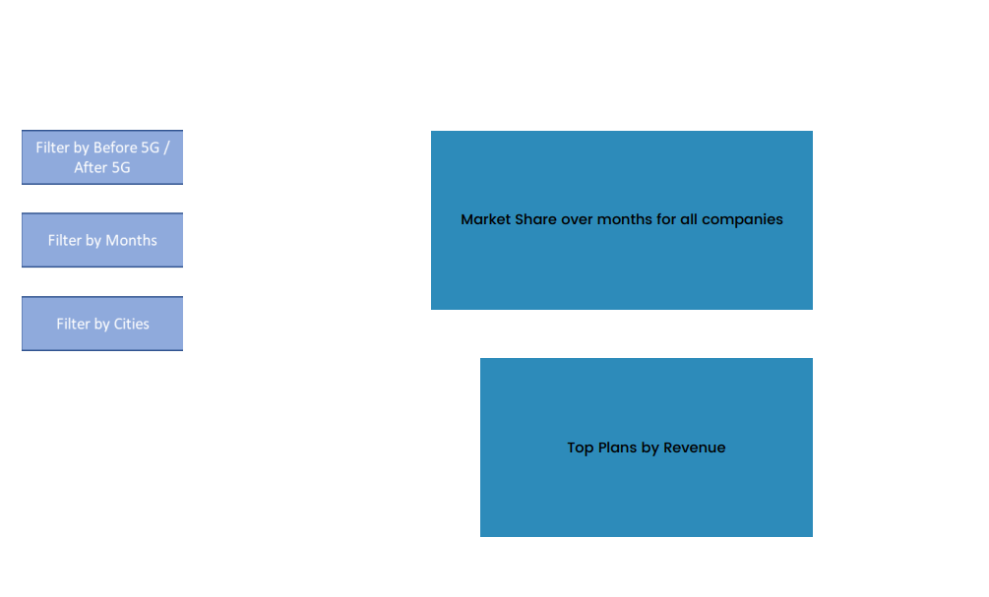
Mock – up Dashboard

Slide 6
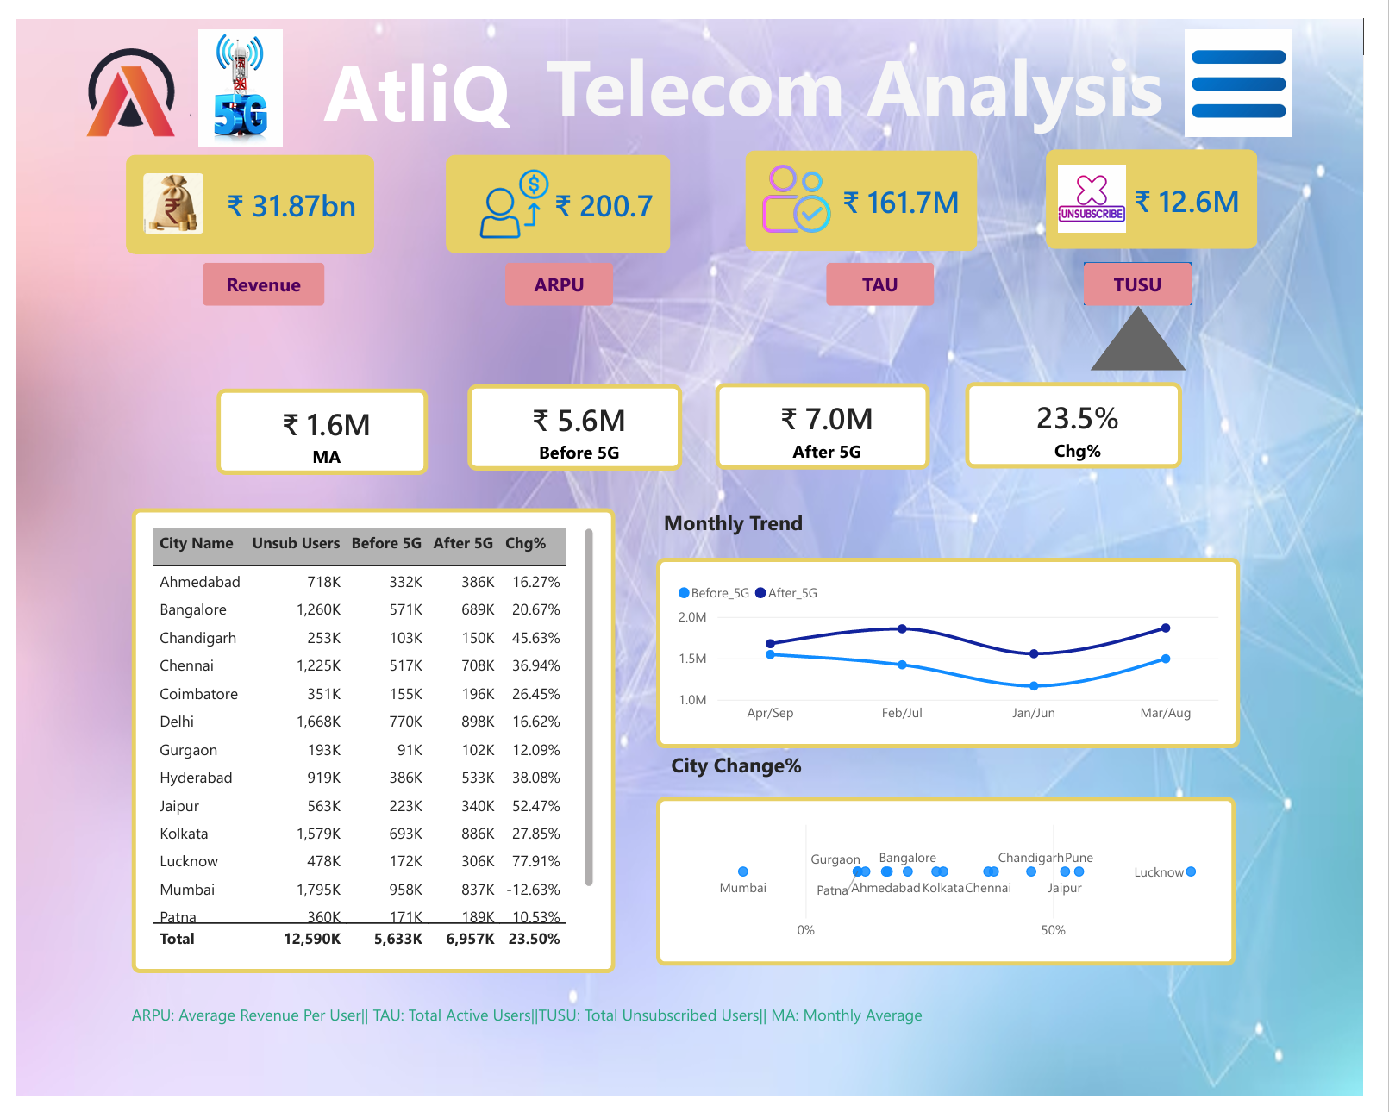
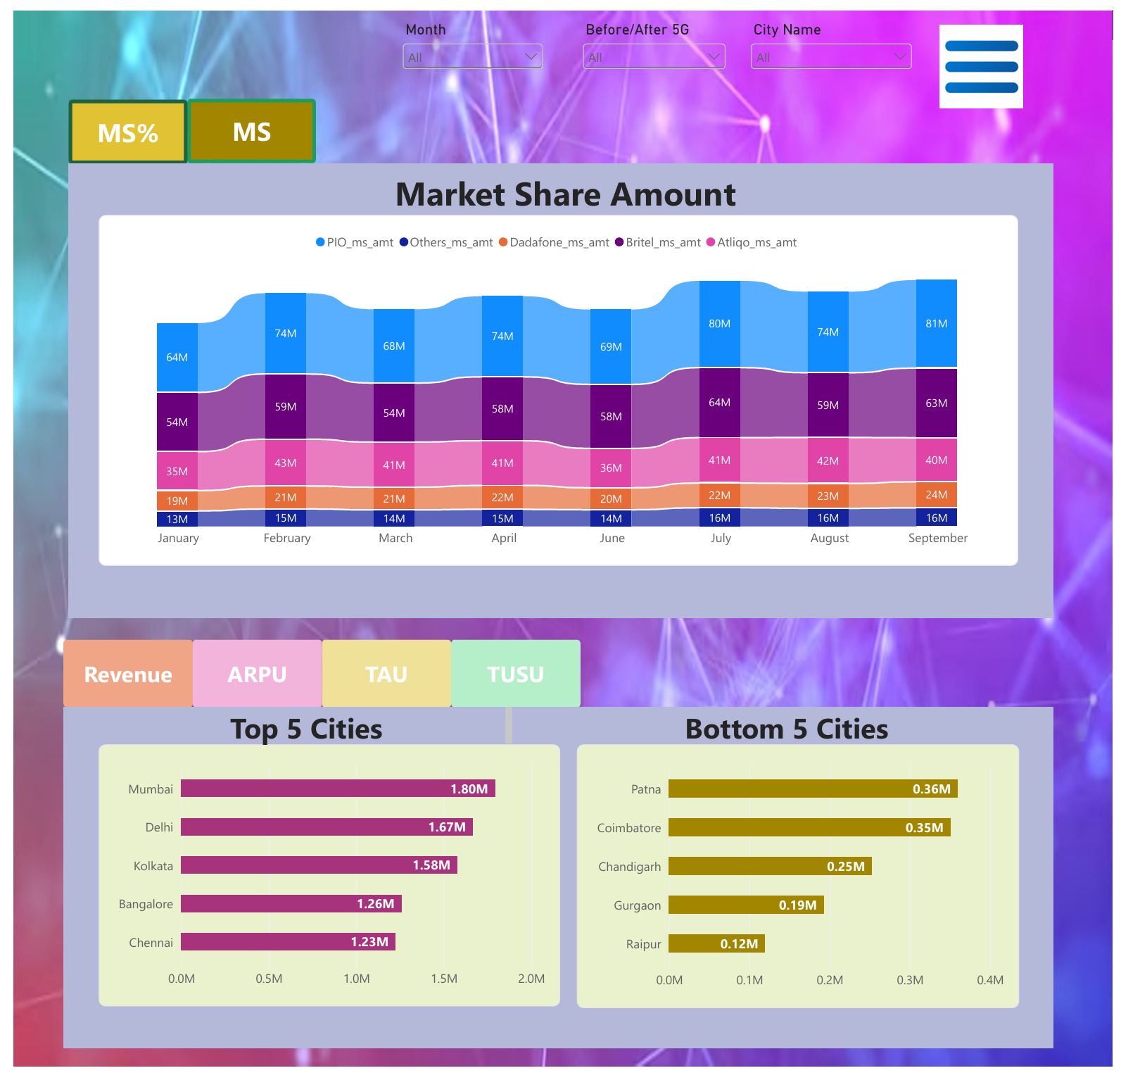
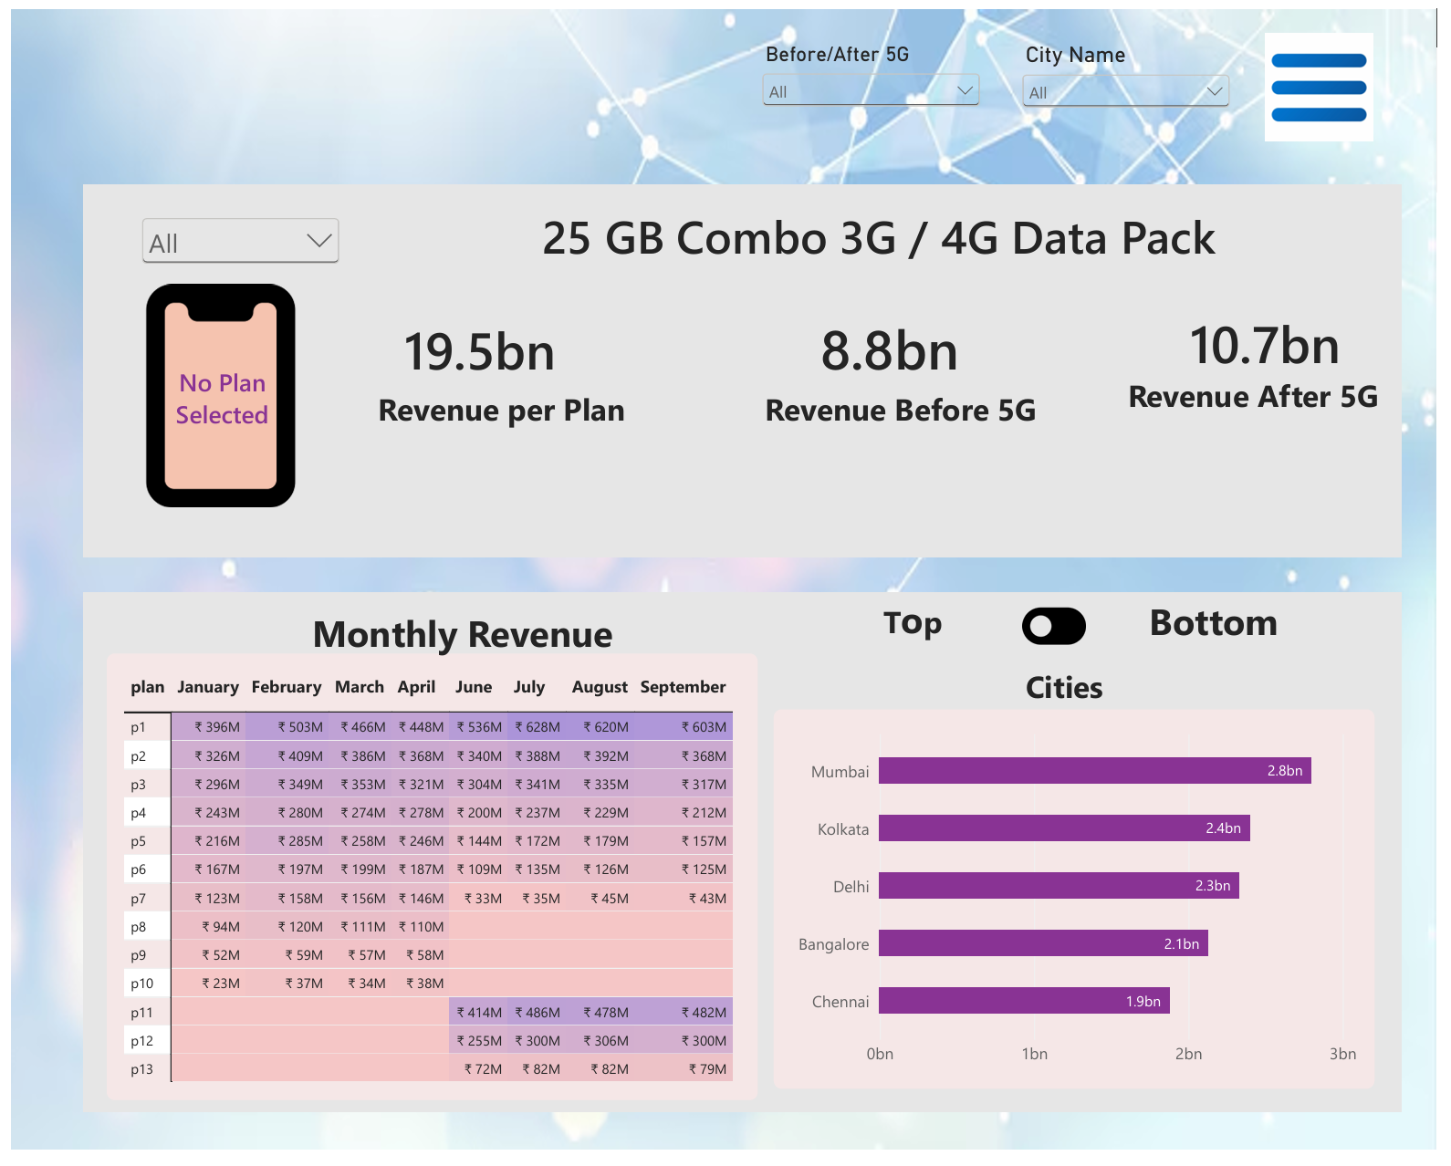
My Design

Slide 7
Thank You

